Slide 1

Application: Custom Threads Type: Application Architecture View: Logical View Style: Layered Architecture Pattern
Users
Delivery Channels
Core Business Processes
Data And Information
Technology Enablers
Marketplace Operation
User Details
Payment Gateways
Customers
Order Processing
Order Details
Analytics Monitoring
CI/CD Pipeline
Design Data
Payment Management
Payment Information
Design Tools API
Web Browser
Manage Subscriptions
Designer
Analytics Data
Email Platform
Commission Management
Feedback Data
Storage Services
Shipping Management
Shipping Data
Github & Delivery Pipeline
Administrator
Support Management
Commission Data

Slide 2
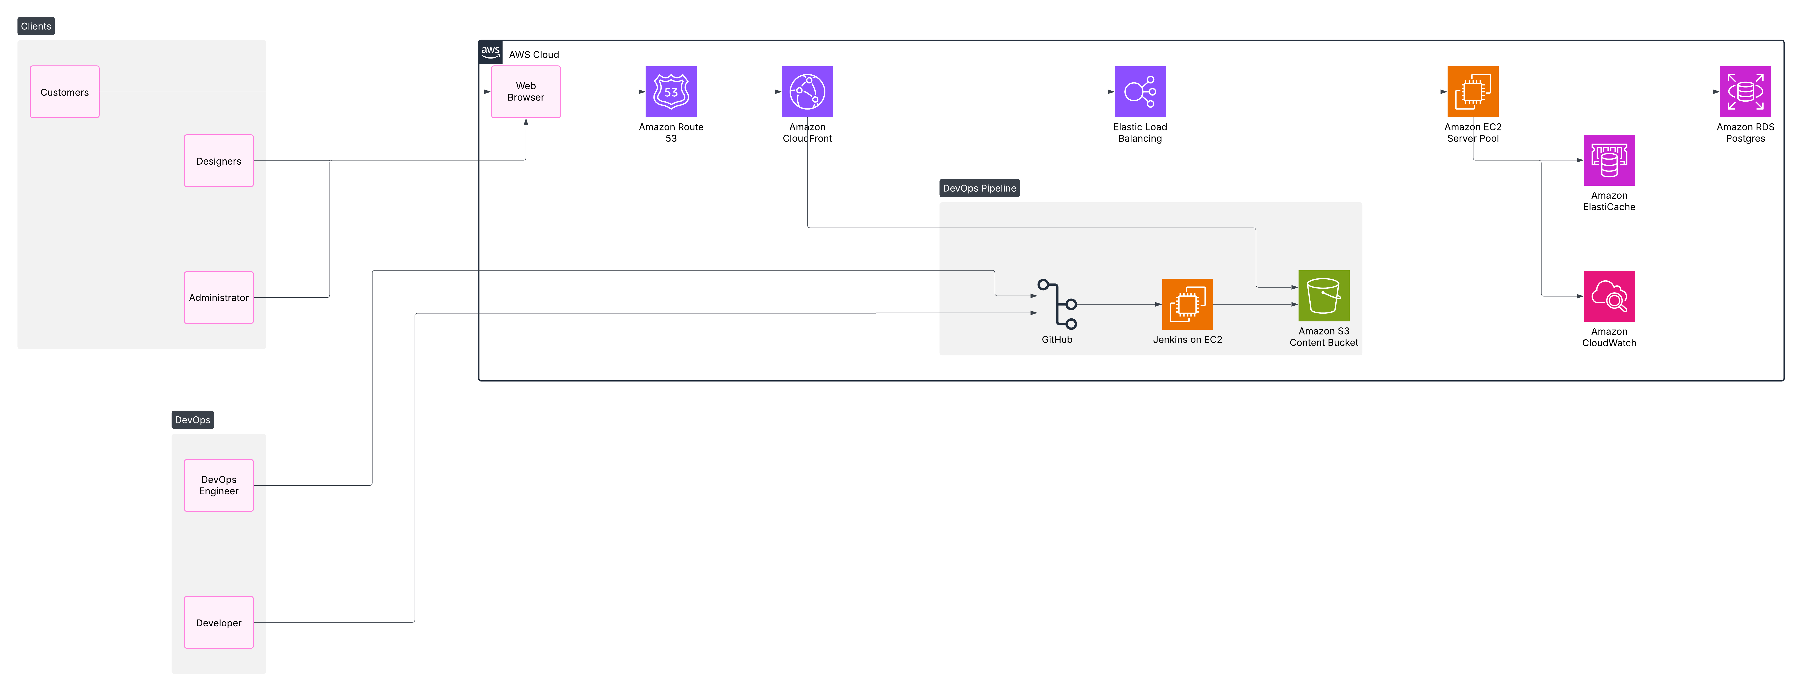
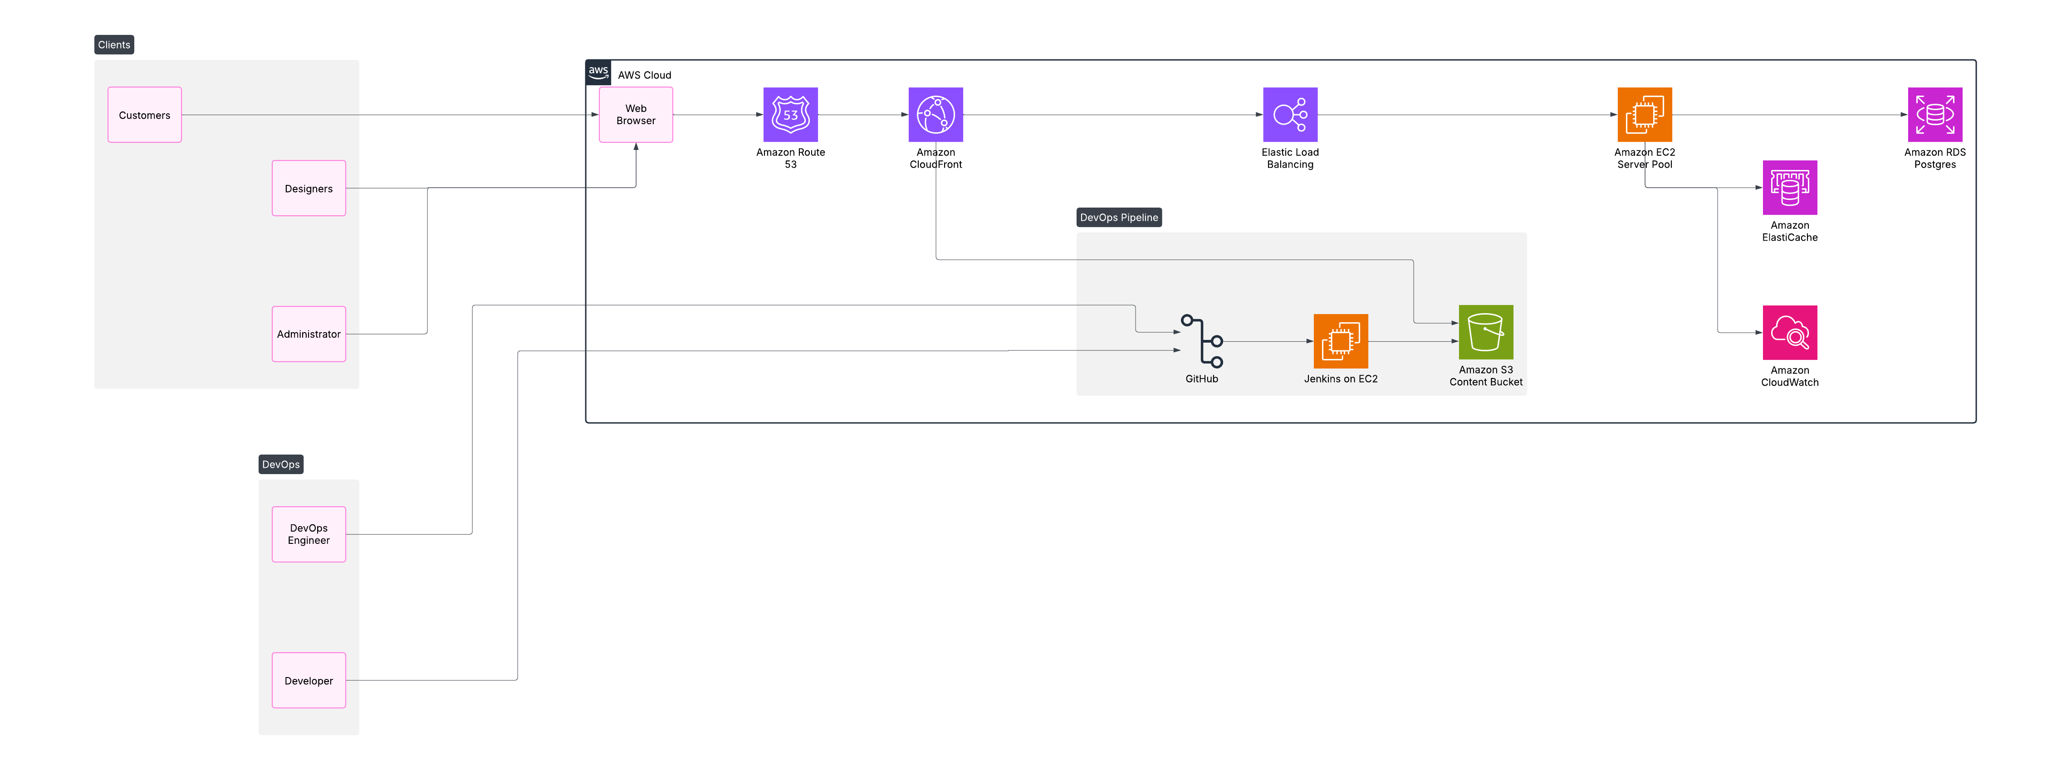
Application: Custom Threads Type: Application Architecture View: Process View Style: Client-Server Pattern

